Slide 1
Multiplexing : Sharing a Medium

Slide 2
Introduction
Under the simplest conditions, a medium can carry only one signal at any moment in time.
For multiple signals to share one medium, the medium must somehow be divided, giving each signal a portion of the total bandwidth.
The current techniques that can accomplish this include
  frequency division multiplexing (FDM)
  time division multiplexing (TDM)
    Synchronous vs statistical
  wavelength division multiplexing (WDM)
  code division multiplexing (CDM)

Slide 3
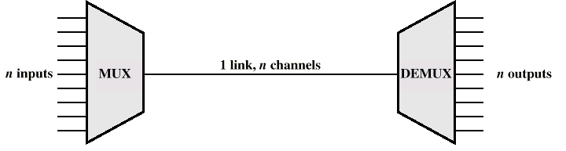
Multiplexing
Multiplexor (MUX)
Demultiplexor (DEMUX)
  Sometimes just called a MUX

Slide 4
Multiplexing
Two or more simultaneous transmissions on a single circuit.
  Transparent to end user.
Multiplexing costs less.

Slide 5
Data Communications and Computer Networks
Chapter 5
Frequency Division Multiplexing
Assignment of non-overlapping frequency ranges to each “user” or signal on a medium. Thus, all signals are transmitted at the same time, each using different frequencies.
A multiplexor accepts inputs and assigns frequencies to each device.
The multiplexor is attached to a high-speed communications line.
A corresponding multiplexor, or demultiplexor, is on the end of the high-speed line and separates the multiplexed signals.

Slide 6
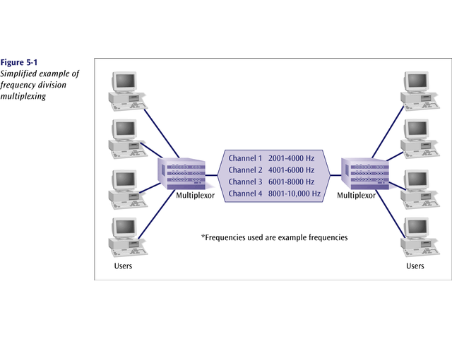
Data Communications and Computer Networks
Chapter 5

Slide 7
Data Communications and Computer Networks
Chapter 5
Frequency Division Multiplexing
Analog signaling is used to transmits the signals.
Broadcast radio and television, cable television, and the AMPS cellular phone systems use frequency division multiplexing.
This technique is the oldest multiplexing technique.
Since it involves analog signaling, it is more susceptible to noise.

Slide 8
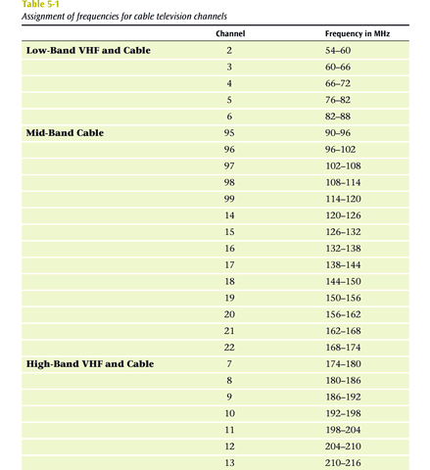

Slide 9
Data Communications and Computer Networks
Chapter 5
Time Division Multiplexing
Sharing of the signal is accomplished by dividing available transmission time on a medium among users.
Digital signaling is used exclusively.
Time division multiplexing comes in two basic forms:
  1. Synchronous time division multiplexing, and
  2. Statistical, or asynchronous time division multiplexing.

Slide 10
Data Communications and Computer Networks
Chapter 5
Synchronous Time Division Multiplexing
The original time division multiplexing.
The multiplexor accepts input from attached devices in a round-robin fashion and transmit the data in a never ending pattern.
T-1 and ISDN telephone lines are common examples of synchronous time division multiplexing.

Slide 11
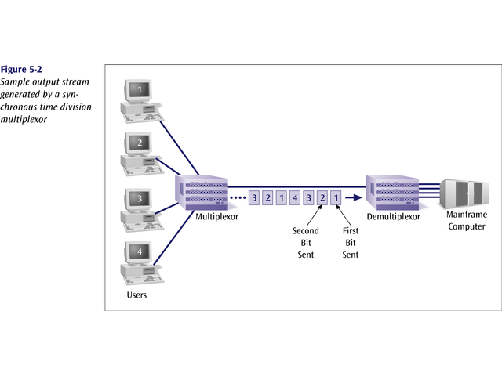
Data Communications and Computer Networks
Chapter 5

Slide 12
Data Communications and Computer Networks
Chapter 5
Synchronous Time Division Multiplexing
If one device generates data at a faster rate than other devices, then the multiplexor must either sample the incoming data stream from that device more often than it samples the other devices, or buffer the faster incoming stream.
If a device has nothing to transmit, the multiplexor must still insert a piece of data from that device into the multiplexed stream.

Slide 13
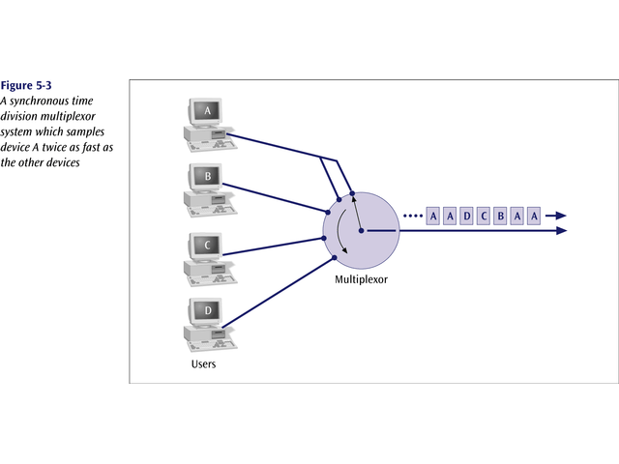
Data Communications and Computer Networks
Chapter 5

Slide 14
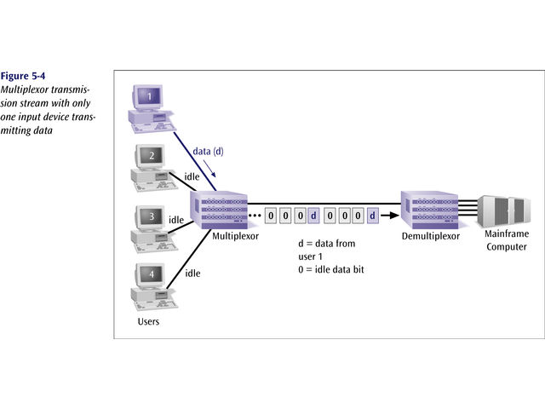
Data Communications and Computer Networks
Chapter 5

Slide 15
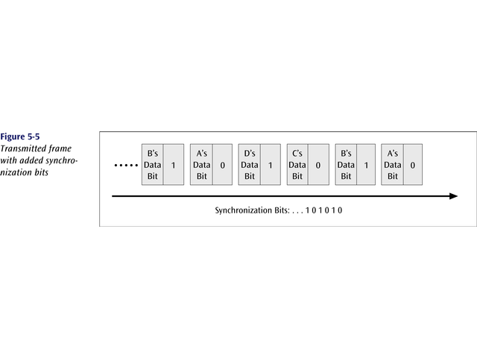
Synchronous time division multiplexing
So that the receiver may stay synchronized with the incoming data stream, the transmitting multiplexor can insert alternating 1s and 0s into the data stream.

Slide 16
Data Communications and Computer Networks
Chapter 5
Synchronous Time Division Multiplexing
Three types popular today:
  T-1 multiplexing (the classic)
  ISDN multiplexing
  SONET (Synchronous Optical NETwork)

Slide 17
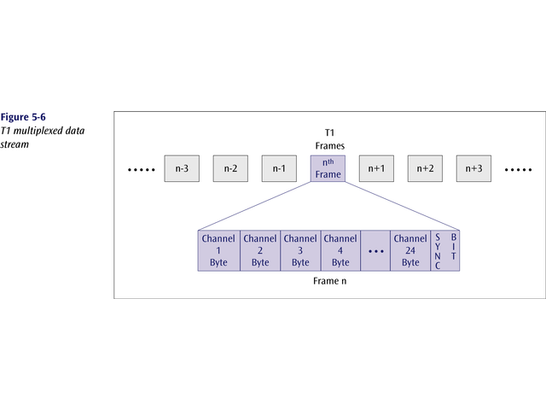
The T1 (1.54 Mbps) multiplexor stream is a continuous series of frames of both digitized data and voice channels.
24 separate 64Kbps channels

Slide 18
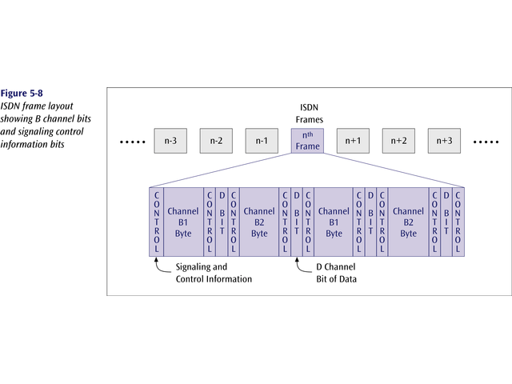
Data Communications and Computer Networks
Chapter 5
The ISDN multiplexor stream is also a continuous stream of frames. Each frame contains various control and sync info.

Slide 19
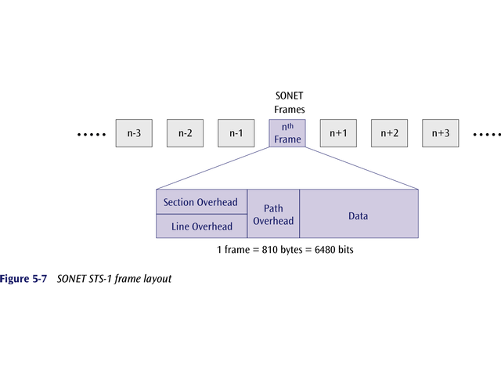
Data Communications and Computer Networks
Chapter 5
SONET – massive data rates

Slide 20
Synchronous TDM
Very popular
Line will require as much bandwidth as all the bandwidths of the sources

Slide 21
Data Communications and Computer Networks
Chapter 5
Statistical Time Division Multiplexing
A statistical multiplexor transmits only the data from active workstations (or why work when you don’t have to).
If a workstation is not active, no space is wasted on the multiplexed stream.
A statistical multiplexor accepts the incoming data streams and creates a frame containing only the data to be transmitted.

Slide 22
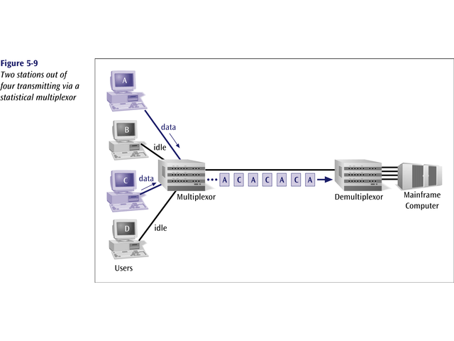
Data Communications and Computer Networks
Chapter 5

Slide 23
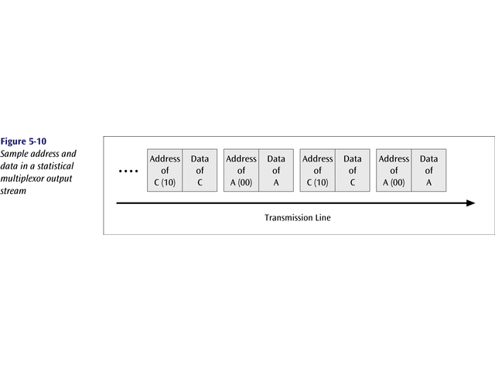
Data Communications and Computer Networks
Chapter 5
To identify each piece of data, an address is included.

Slide 24
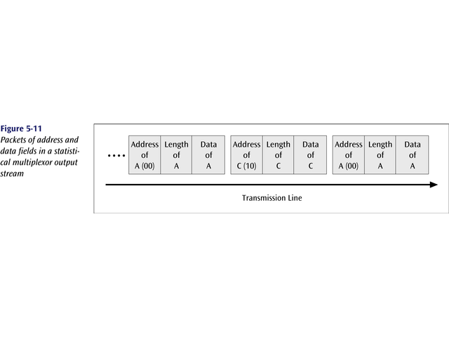
Data Communications and Computer Networks
Chapter 5
If the data is of variable size, a length is also included.

Slide 25
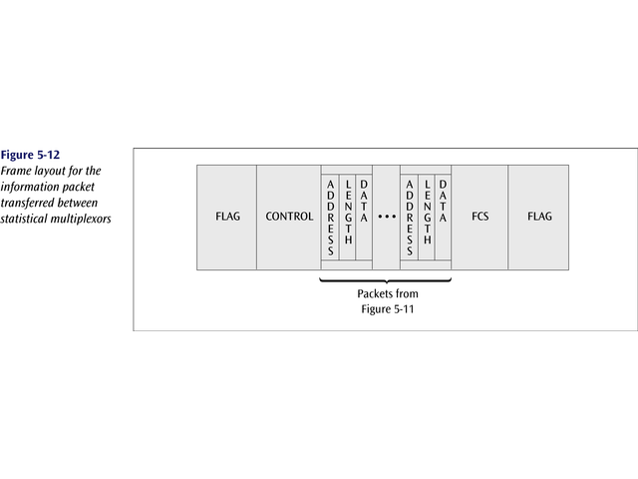
Data Communications and Computer Networks
Chapter 5
More precisely, the transmitted frame contains a collection of data groups.

Slide 26
Data Communications and Computer Networks
Chapter 5
Statistical Time Division Multiplexing
A statistical multiplexor does not require a line over as high a speed line as synchronous time division multiplexing since STDM does not assume all sources will transmit all of the time!
Good for low bandwidth lines (used for LANs)
Much more efficient use of bandwidth!

Slide 27
Data Communications and Computer Networks
Chapter 5
Wavelength Division Multiplexing (WDM)
Give each message a different wavelength (frequency)
Easy to do with fiber optics and optical sources

Slide 28
Dense Wavelength Division Multiplexing (DWDM)
Dense wavelength division multiplexing is often called just wavelength division multiplexing
Dense wavelength division multiplexing multiplexes multiple data streams onto a single fiber optic line.
Different wavelength lasers (called lambdas) transmit the multiple signals.
Each signal carried on the fiber can be transmitted at a different rate from the other signals.
Dense wavelength division multiplexing combines many (30, 40, 50, 60, more?) onto one fiber.

Slide 29
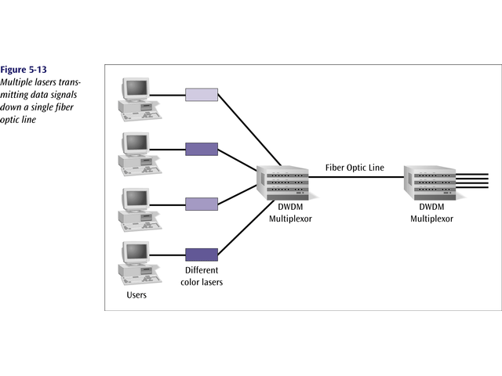
Data Communications and Computer Networks
Chapter 5

Slide 30
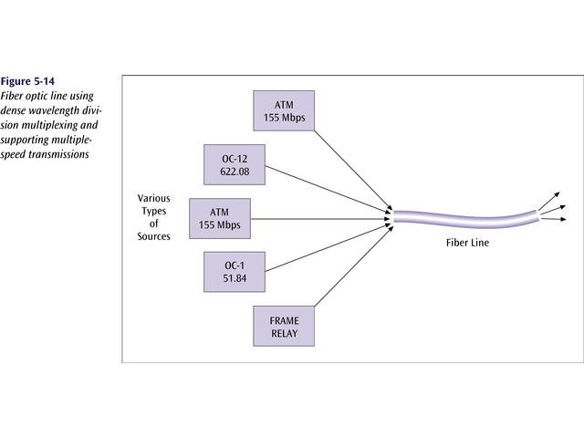
Data Communications and Computer Networks
Chapter 5

Slide 31
Data Communications and Computer Networks
Chapter 5
Code Division Multiplexing (CDM)
  Old but now new method
Also known as code division multiple access (CDMA)
An advanced technique that allows multiple devices to transmit on the same frequencies at the same time using different codes
Used for mobile communications

Slide 32
Data Communications and Computer Networks
Chapter 5
Code Division Multiplexing
An advanced technique that allows multiple devices to transmit on the same frequencies at the same time.
Each mobile device is assigned a unique 64-bit code (chip spreading code)
To send a binary 1, mobile device transmits the unique code
To send a binary 0, mobile device transmits the inverse of code

Slide 33
Data Communications and Computer Networks
Chapter 5
Code Division Multiplexing
Receiver gets summed signal, multiplies it by receiver code, adds up the resulting values
Interprets as a binary 1 if sum is near +64
Interprets as a binary 0 if sum is near –64

Slide 34
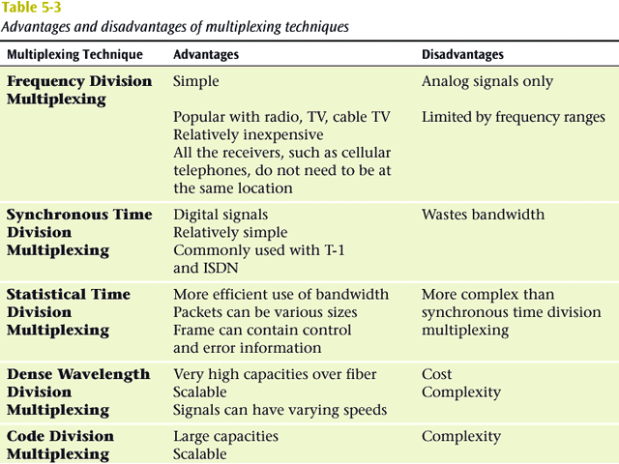

Slide 35
Data Communications and Computer Networks
Chapter 5
Business Multiplexing In Action
XYZ Corporation has two buildings separated by a distance of 300 meters.
A 3-inch diameter tunnel extends underground between the two buildings.
Building A has a mainframe computer and Building B has 66 terminals.
List some efficient techniques to link the two buildings.

Slide 36
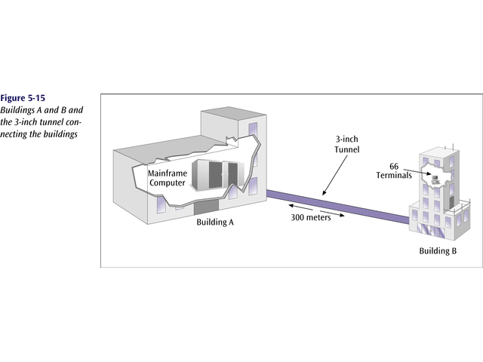
Data Communications and Computer Networks
Chapter 5

Slide 37
Data Communications and Computer Networks
Chapter 5
Possible Solutions
Connect each terminal to the mainframe computer using separate point-to-point lines.
Connect all the terminals to the mainframe computer using one multipoint line.
Connect all the terminal outputs and use microwave transmissions to send the data to the mainframe.
Collect all the terminal outputs using multiplexing and send the data to the mainframe computer using a conducted line.

Slide 38
What did we cover
Multiplexing
Types of multiplexing
  TDM
    Synchronous TDM (T-1, ISDN, optical fiber)
    Statistical TDM (LANs)
  FDM (cable, cell phones, broadband)
  WDM (optical fiber)
  CDM (cell phones)

